Slide 1
The Effectiveness of Machine Learning and Deep Learning Algorithms for Cyber Security

Slide 2
TABLE OF CONTENT
INTRODUCTION
TYPES OF ML ALGORITHMS USED IN CS
TYPES OF DL ALGORITHMS USED IN CS
APPLICATIONS OF ML AND DL IN CS
OUR WORK
DATASET
Preprocessing
Evaluation
ADVANTAGES OF USING ML AND DL IN CS
CHALLENGES AND LIMITATIONS OF USING ML AND DL IN CS
CONCLUSION

Slide 3

INTRODUCTION

Slide 4

Machine learning and deep learning algorithms have been applied to a variety of cyber security tasks, including intrusion detection, malware classification, and network analysis. These approaches have the potential to be very effective because they can automatically learn patterns in data and make decisions based on those patterns. This can allow them to identify and classify malicious activity more accurately than traditional rule-based approaches.

Slide 5
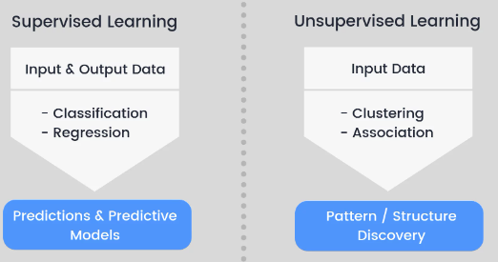
TYPES OF MACHINE LEARNING ALGORITHMS USED IN CYBER SECURITY
Notes:
Types of machine learning algorithms used in cyber security Supervised learning :
***Supervised learning algorithms can be used for classification tasks, where the goal is to predict a class label (e.g., "malicious" or "benign"), or for regression tasks, where the goal is to predict a continuous numerical value
*** Unsupervised learning :Unsupervised learning algorithms can be used for tasks such as clustering and association , where the goal is to identify unusual patterns and the relationships between different data points or behaviors that may indicate a security threat

Slide 6
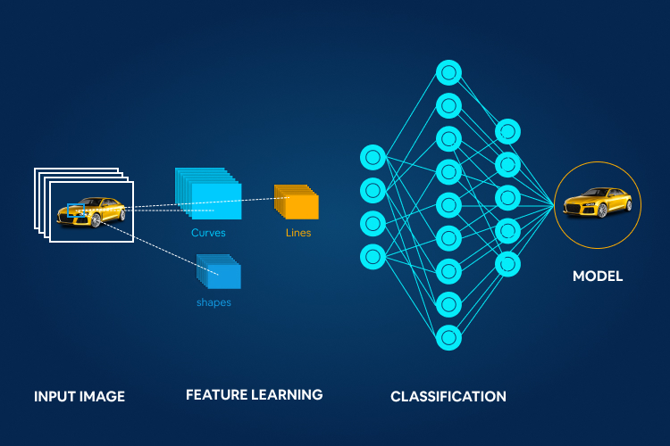
TYPES OF DEEP LEARNING ALGORITHMS USED IN CYBER SECURITY
Convolutional neural networks (CNNs):
Notes:
Types of deep learning algorithms used in cyber security
Convolutional neural networks (CNNs):They are often used for tasks such as image classification and object detection. In the context of cyber security, CNNs may be used for tasks such as identifying malicious images or analyzing network traffic for signs of an intrusion.

Slide 7
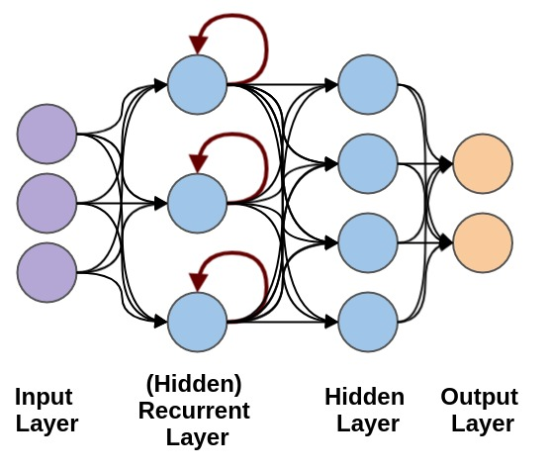
TYPES OF DEEP LEARNING ALGORITHMS USED IN CYBER SECURITY
Recurrent neural networks (RNNs):
Notes:
Recurrent neural networks (RNNs): They are often used for tasks such as language translation and speech recognition. In the context of cyber security, RNNs may be used for tasks such as analyzing log files or detecting anomalies in network traffic

Slide 8
APPLICATIONS OF MACHINE LEARNING AND DEEP LEARNING IN CYBER SECURITY
Network intrusion detection
The Model can be trained to recognize patterns and anomalies in network traffic that may indicate an intrusion attempt.
Malware detection
identify malware by analyzing the behavior of programs or the characteristics of files
Phishing detection
identify phishing attacks by analyzing the content and structure of emails or other communications

Slide 9
OUR WORK

Slide 10
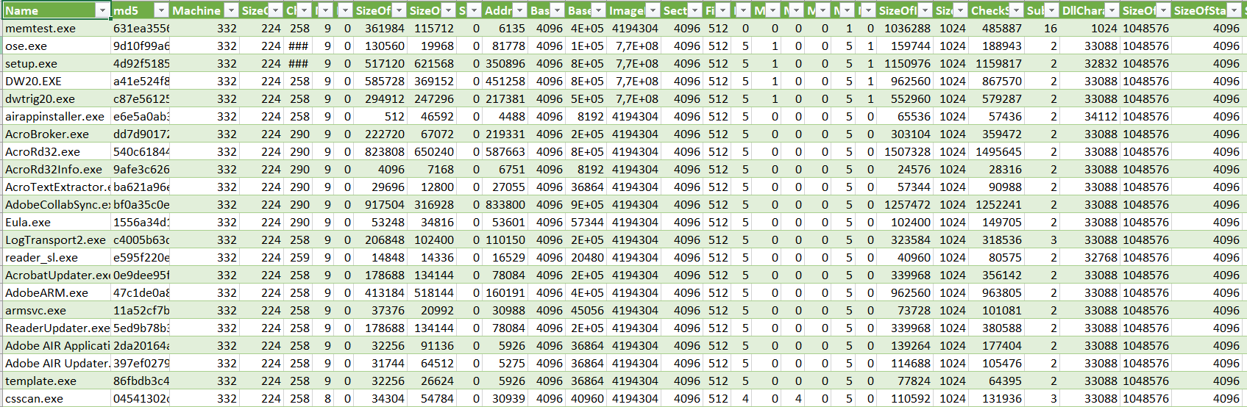

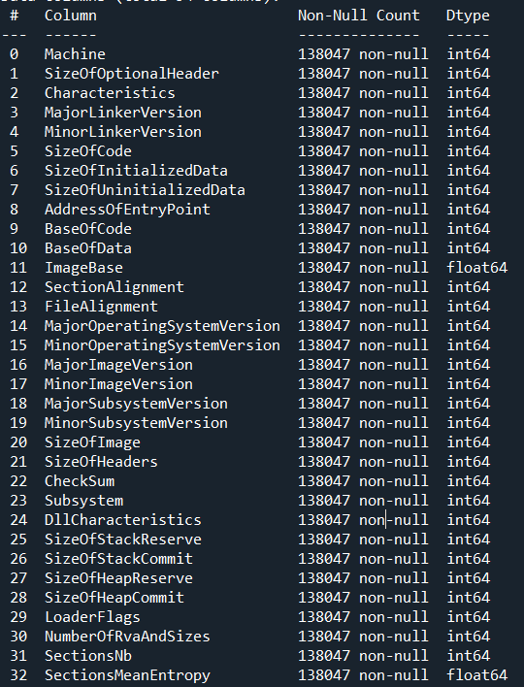
DATASET

Slide 11
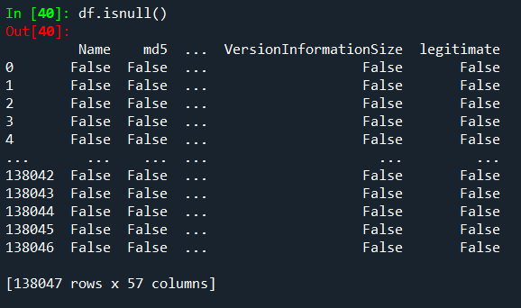

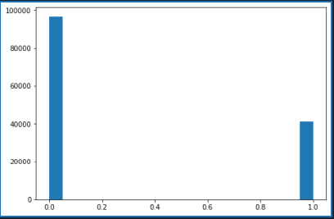


Preprocessing

Slide 12
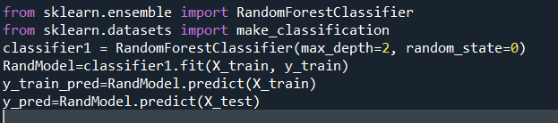

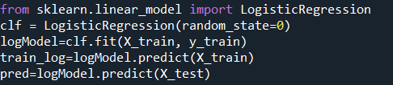

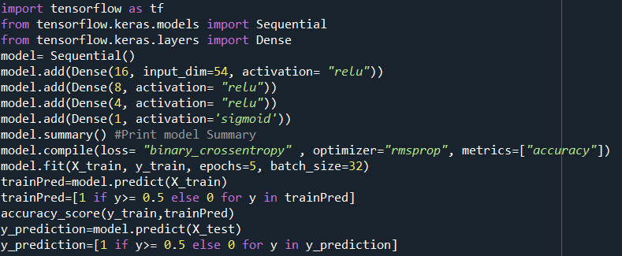

Evaluation

Slide 13
ADVANTAGES OF USING MACHINE LEARNING AND DEEP LEARNING IN CYBER SECURITY
Scalability
ML / DL algorithms are able to analyze large amounts of data quickly and accurately, making them well-suited for tasks such as network intrusion detection and malware analysis, which can generate vast amounts of data.
Accuracy
ML / DL algorithms can detect patterns and anomalies that humans may not be able to identify, which can help improve the accuracy of security systems
Adaptability
ML / DL algorithms can continuously learn and improve over time, which can help them adapt to changing threats and evolving tactics used by attackers.

Slide 14
CHALLENGES AND LIMITATIONS OF USING MACHINE LEARNING AND DEEP LEARNING IN CYBER SECURITY
Need for labeled data
ML algorithms require a large amount of labeled data in order to learn effectively. This can be a challenge in the field of cyber security, where it may be difficult to obtain a sufficient number of labeled examples of certain types of attacks .
Limited interpretability
Some ML algorithms, particularly DL algorithms, can be difficult to interpret, which can make it hard to understand how they arrived at a particular prediction. This can be a problem in the context of cyber security, where it is important to be able to understand the reasoning behind a model's prediction.
Overfitting
ML algorithms can sometimes "overfit" the training data, which means that they perform well on the training data but poorly on new data. This can be a problem in the field of cyber security, where it is important for algorithms to generalize well to new situations.

Slide 15
CONCLUSION

Slide 16
In conclusion, machine learning and deep learning algorithms can be very effective tools for addressing a wide range of cyber security problems. These algorithms can analyze and process large amounts of data quickly and accurately and can be trained to recognize patterns and trends that may indicate the presence of a cyber security threat. They can also be used to automatically classify and categorize data in real time, which can help cyber security professionals to identify and respond to threats more quickly and effectively. While there are many challenges and limitations to the use of these algorithms in cyber security, they have the potential to make a significant impact in the field.

Slide 17
REFRENCES
M. S. Pervez and D. M. Farid, ‘‘Feature selection and intrusion classification in NSL-KDD CUP 99 dataset employing
SVMs,’’ in Proc. 8th Int. Conf. Softw., Knowl., Inf. Manage.Appl. (SKIMA), 2014
] E. G. Dada, ‘‘A hybridized SVM-kNN-pd APSO approach to intrusion detection system,’’
in Proc. Fac. Seminar Ser., 2017.
N.Gao, L.Gao, Q.Gao, H.Wang, ‘‘An intrusion detection model based on deep belief networks,’’ in Proc. 2nd Int. Conf. Adv.
Cloud Big Data,2018
C.L.Yin, Y.F.Zhu, J.L.Fei, X.Z.He, ‘‘A deep learning approach for intrusion detection using recurrent neural networks,’’
IEEE 2017
W. Wang, M. Zhu, X. Zeng, X. Ye, and Y. Sheng, ‘‘Malware traffic classification using convolutional neural network for
representation learning,’’ in Proc. Int. Conf. Inf. Newt. 2017.
C. Azad and V. K. Jha, ‘‘Genetic algorithm to solve the problem of small disjunct in the decision tree-based intrusion
detection system,’’ Int. J. Comput. Netw. Inf. Secur. 2017.

